Slide 1


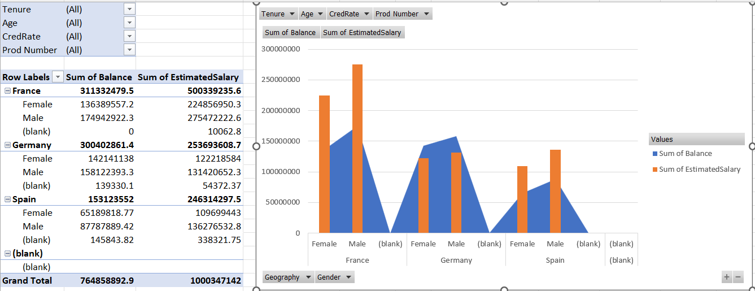
Marketing Analysis
Created by: Vijeta Sinha

Slide 2

Understanding Customer Data
Data Collection
Gathering and compiling information on customers' interactions and transactions with the company.
Data Analysis
Examining and interpreting the collected data to extract valuable insights and patterns.
Consumer Insights
Understanding customer behaviors, preferences, and needs derived from the data.

Slide 3



Customer Demographics
Age
Gender
Location
Understanding the age distribution of the customer base.
Analyzing male-female ratio and its impact on purchasing decisions.
Examining the geographical distribution of customers and its influence on behaviors.

Slide 4

Product and Service Usage
Purchase History
Service Utilization
Customer Experience
Tracking customers' buying history and the frequency of purchases.
Assessing the extent to which customers use the company's services or products.
Evaluating the satisfaction levels and feedback from customers regarding the products or services.

Slide 5

Customer Behavior and Churn Analysis
Purchase Patterns
Analyzing trends in customers' buying habits and preferences.
Churn Rate
Calculating the rate at which customers stop using the company's products or services.
Behavior Analysis
Understanding how customers interact with the company and predicting future behavior.

Slide 6
Marketing Strategies
Target Audience
Promotional Tactics
Identifying and understanding the specific group of customers to market to.
Strategies for promoting and advertising products or services to the target audience.
Brand Positioning
Defining how the brand stands out in the market and is perceived by customers.

Slide 7

Conclusion
Key Findings
Strategic Implications
Summarizing the most important discoveries and insights from the analysis.
Outlining the potential business strategies and decisions based on the analysis results.
Future Recommendations
Suggesting actionable steps and future research areas for further improvement and growth.

